Slide 1
Cloud Computing
Name: Muhammed Yahya Afzal Shaikh
TYBSCIT
Div: A
Roll No: 24

Slide 2
Introduction
The goal of cloud computing is to allow users to take benefit from all of these technologies, without the need for deep knowledge about or expertise with each one of them. The cloud aims to cut costs, and helps the users focus on their core business instead of being impeded by IT obstacles. The main enabling technology for cloud computing is virtualization. Virtualization software separates a physical computing device into one or more "virtual" devices, each of which can be easily used and managed to perform computing tasks. With operating system–level virtualization essentially creating a scalable system of multiple independent computing devices, idle computing resources can be allocated and used more efficiently. Virtualization provides the agility required to speed up IT operations, and reduces cost by increasing infrastructure utilization. Autonomic computing automates the process through which the user can provision resources on-demand. By minimizing user involvement, automation speeds up the process, reduces labor costs and reduces the possibility of human errors

Slide 3
Users routinely face difficult business problems. Cloud computing adopts concepts from Service-oriented Architecture (SOA) that can help the user break these problems into services that can be integrated to provide a solution. Cloud computing provides all of its resources as services and makes use of the well established standards and best practices gained in the domain of SOA to allow global and easy access to cloud services in a standardized way.
Cloud computing also leverages concepts from utility computing to provide metrics for the services used. Such metrics are at the core of the public cloud pay-per-use models. In addition, measured services are an essential part of the feedback loop in autonomic computing, allowing services to scale on-demand and to perform automatic failure recovery. Cloud computing is a kind of grid computing; it has evolved by addressing the QoS (quality of service) and reliability problems. Cloud computing provides the tools and technologies to build data/compute intensive parallel applications with much more affordable prices compared to traditional parallel computing techniques.

Slide 4
Businesses using cloud storage can cut their energy consumption by up to 70% making them a greener business. Also at the vendor level they are dealing with higher levels of energy so they will be more equipped with managing it in order to keep their own costs down as well. Cloud storage can be used for copying virtual machine images from the cloud to on-premises locations or to import a virtual machine image from an on-premises location to the cloud image library. In addition, cloud storage can be used to move virtual machine images between user accounts or between data centers. Cloud storage can be used as natural disaster proof backup, as normally there are 2 or 3 different backup servers located in different places around the globe. Cloud storage can be mapped as a local drive with the WebDAV protocol. It can function as a central file server for organizations with multiple office locations.

Slide 5
Software Requirement
Server Requirement:
PHP 5.5+ require at least Windows 2008/Vista, or 2008r2, 2012, 2012r2, 2016 or 7, 8, 8.1, 10. Either 32-Bit or 64-bit (aka X86 or X64. PHP does not run on Windows RT/WOA/ARM). As of PHP 7.2.0 Windows 2008 and Vista are no longer supported.
PHP requires the Visual C runtime(CRT). Many applications require that so it may already be installed.
PHP 5.5 and 5.6 require VC CRT 11
PHP 7.0+ requires VC CRT 14

Slide 6
You MUST download the x86 CRT for PHP x86 builds and the x64 CRT for PHP x64 builds.
If CRT is already installed, the installer will tell you that and not change anything.
The CRT installer supports the /quiet and /norestart command-line switches, so you can script running it.
VC11 CRT DLLs can be copied from your local machine to a remote machine(a `Copy Deployment` installation) instead of running the installer on the remote machine (such as a web server you have restricted access to). See: http://www.sitepoint.com/install-php53-windows/
VC14 CRT does not support a `Copy Deployment` installation. VC14 CRT has many more DLLs(most in files with names starting with api-*). If you can find them all and copy them, it will also work (try a tool like Resource Hacker to get a list of all the DLLs to copy).

Slide 7
User Requirement:
Operating System : Any
Web Browser : All industry standard web browsers (Internet Explorer, Mozilla Firefox, Google Chrome, Apple Safari)

Slide 8
System Design
Architectural design
The architectural design of a system emphasizes the design of the system architecture that describes the structure, behavior and more views of that system and analysis.
Logical design
The logical design of a system pertains to an abstract representation of the data flows, inputs and outputs of the system. This is often conducted via modelling, using an over-abstract (and sometimes graphical) model of the actual system. In the context of systems, designs are included. Logical design includes entity-relationship diagrams (ER diagrams).

Slide 9
Physical design
The physical design relates to the actual input and output processes of the system. This is explained in terms of how data is input into a system, how it is verified/authenticated, how it is processed, and how it is displayed. In physical design, the following requirements about the system are decided.
Input requirement,
Output requirements,
Storage requirements,
Processing requirements,
System control and backup or recovery.
Put another way, the physical portion of system design can generally be broken down into three sub-tasks:
User Interface Design
Data Design
Process Design

Slide 10
User Interface Design is concerned with how users add information to the system and with how the system presents information back to them. Data Design is concerned with how the data is represented and stored within the system. Finally, Process Design is concerned with how data moves through the system, and with how and where it is validated, secured and/or transformed as it flows into, through and out of the system. At the end of the system design phase, documentation describing the three sub-tasks is produced and made available for use in the next phase.
Physical design, in this context, does not refer to the tangible physical design of an information system. To use an analogy, a personal computer's physical design involves input via a keyboard, processing within the CPU, and output via a monitor, printer, etc. It would not concern the actual layout of the tangible hardware, which for a PC would be a monitor, CPU, motherboard, hard drive, modems, video/graphics cards, USB slots, etc. It involves a detailed design of a user and a product database structure processor and a control processor. The H/S personal specification is developed for the proposed system.

Slide 11
Conceptual Models

Slide 12

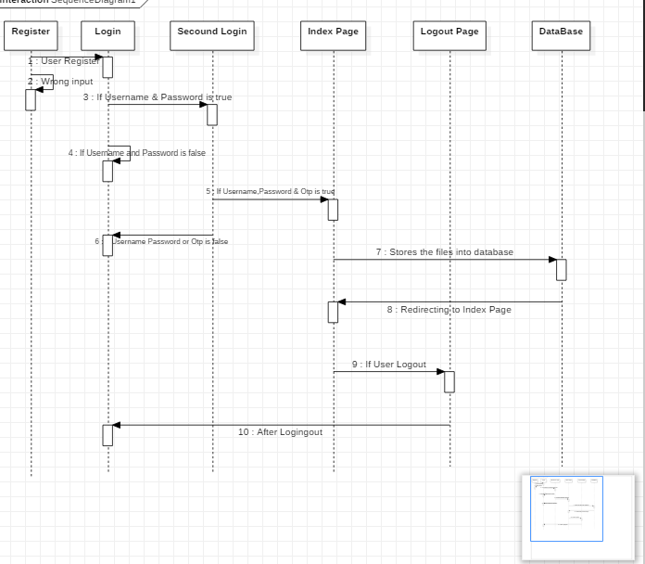

Slide 13
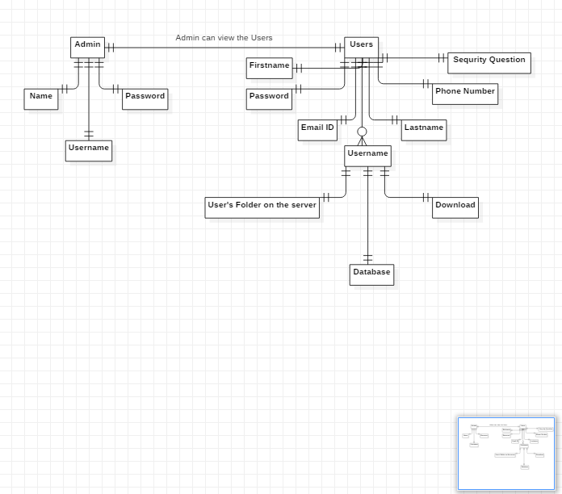

Slide 14
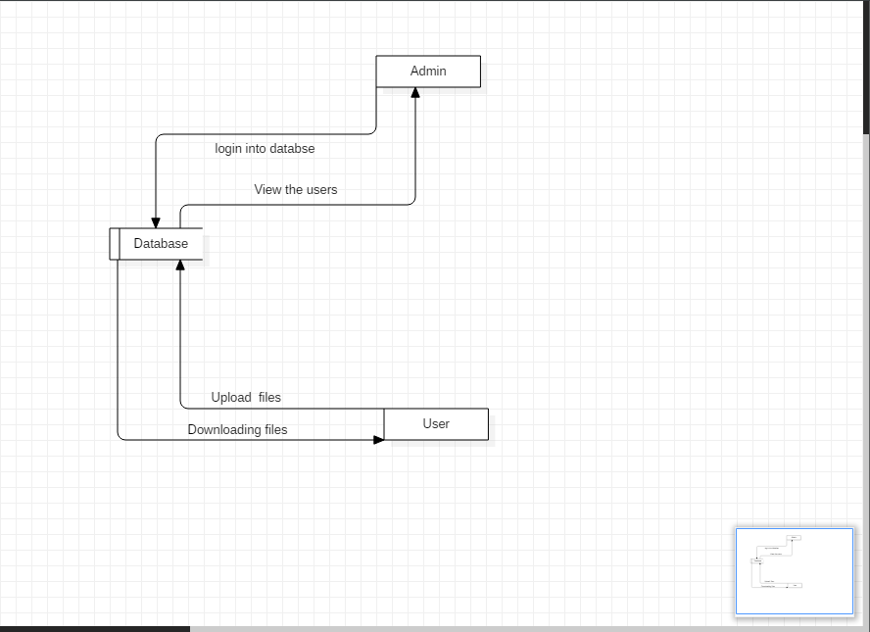

Slide 15
Advantages
Usability: All cloud storage services reviewed in this topic have desktop folders for Mac’s and PC’s. This allows users to drag and drop files between the cloud storage and their local storage.
Bandwidth: You can avoid emailing files to individuals and instead send a web link to recipients through your email.
Accessibility: Stored files can be accessed from anywhere via Internet connection.
Disaster Recovery: It is highly recommended that businesses have an emergency backup plan ready in the case of an emergency. Cloud storage can be used as a back‐up plan by businesses by providing a second copy of important files. These files are stored at a remote location and can be accessed through an internet connection.
Cost Savings: Businesses and organizations can often reduce annual operating costs by using cloud storage; cloud storage costs about 3 cents per gigabyte to store data internally. Users can see additional cost savings because it does not require internal power to store information remotely.

Slide 16
Disadvantages
Security and Privacy: Any discussion involving data must address security and privacy, especially when it comes to managing sensitive data. We must not forget what happened at Code Space and the hacking of their AWS EC2 console, which led to data deletion and the eventual shutdown of the company. Their dependence on remote cloud-based infrastructure meant taking on the risks of outsourcing everything. Of course, any cloud service provider is expected to manage and safeguard the underlying hardware infrastructure of a deployment. However, your responsibilities lie in the realm of user access management, and it’s up to you to carefully weigh all the risk scenarios.

Slide 17
Vulnerability to Attack: In cloud computing, every component is online, which exposes potential vulnerabilities. Even the best teams suffer severe attacks and security breaches from time to time. Since cloud computing is built as a public service, it’s easy to run before you learn to walk. After all, no one at a cloud vendor checks your administration skills before granting you an account: all it takes to get started is generally a valid credit card.
Limited control and flexibility: To varying degrees (depending on the service), cloud users may find they have less control over the function and execution of services within a cloud-hosted infrastructure. A cloud provider’s end-user license agreement (EULA) and management policies might impose limits on what customers can do with their deployments. Customers retain control of their applications, data, and services, but may not have the same level of control over their backend infrastructure.

Slide 18
Future Scope
According to the statistics provided by the Market Research Media, the worldwide market for Cloud Computing is likely to grow at a CAGR of 30% to reach US$ 270 billion through the year 2020. Considering the cutting-edge innovations and new industry-specific applications, Cloud Computing is fast emerging as an essential component of an enterprise’s IT framework.

Slide 19
Organizations, both big and small have deployed the cloud technology in some suitable capacity. Enterprises need expert IT professionals to work around ‘the cloud’. The Cloud Computing industry requires professionals with adept training and knowledge in both technical and managerial fields. The demand for IT professionals continues to rise at an exponential rate as more and more enterprises adopt Cloud Computing.
Aspirants focused on taking a plunge into the Cloud can choose from a range of career paths such as Cloud architects, Cloud engineers, Cloud security experts, Cloud developers, Cloud support analysts to name a few. Similar to all other IT jobs, jobs in the Cloud Computing stream involve considerably high pay packages. Even the entry level jobs receive fat pay packages, making the sector more lucrative for ambitious professionals.

Slide 20
References
https://en.wikipedia.org/wiki/Cloud_storage
https://www.computerweekly.com/feature/A-history-of-cloud-computing
https://jakearchibald.github.io/isserviceworkerready/demos/transform-stream/cloud.html
https://www.researchgate.net/publication/230668912_A_review_and_analysis_of_technologies_for_developing_web_applications
https://www.brighthubpm.com/project-planning/56372-types-of-feasibility-studies/
https://inurture.co.in/blog/cloud-computing-and-its-scope-in-future/
https://en.wikipedia.org/wiki/Systems_design

